Slide 1
Mobile Agent Rendezvous Problem in a Ring
Roberta Capuano,Vikas Kumar Jha

Slide 2
AGENDA
The renzezvous dilemma
Definitions
Mobile agent in rendezvous in a ring
Rendezvous asymmetry
Rendezvous symmetry
How to break symmetry ?
Algorithms
Conclusion
References

Slide 3
The Rendezvous Dilemma
Formalized by Steve Alpern[1,2] in 1976
“Two young people have a date in a park they have never been to before. Arriving separately in the park, they are both surprised to discover that it is a huge area and consequently they cannot find one another. In this situation each person has to choose between waiting in a fixed place in the hope that the other will find them, or else starting to look for the other in the hope that they have chosen to wait somewhere.”

Slide 4
An Example: The Rendezvous Problem
An example of this class of problem is known as rendezvous problem.
Recently the theoretical computer science community has taken up the challenge of the problem of rendezvous for autonomous software agents moving through a distributed network. Requiring such agents to meet in order to synchronize, share information, divide up duties, etc. would seem to be a natural fundamental operation useful as a subroutine in more complicated applications such as web-crawling, peer-to-peer lookup, meeting scheduling, etc. [3]

Slide 5
Definitions (1/3)
Mobile agent: It is a set of software entities that act more or less autonomously from their originator and have the ability to move from node to node in a distributed network. Each mobile agent is modeled as a set of states and transition function.
Deterministic: We have the knowledge of the behavior of the agents.
Randomized: Has a source of randomness that is taken as input.
Anonymous Agents: Agents without identities. Anonymous agents are limited to running precisely the same program.
Non-Anonymous Agents: The agents are distinguishable. As the identity is assumed to be part of the starting state of the automaton, agents with identities have the potential to run different programs.

Slide 6
Definitions (2/3)
Distributed network: It is essentially inherited directly from the theory of distributed computing. We model the network by a graph whose vertices comprise the computing nodes and edges correspond to communication links.
Anonymous
Non anonymous
Synchronous
Asynchronous

Slide 7
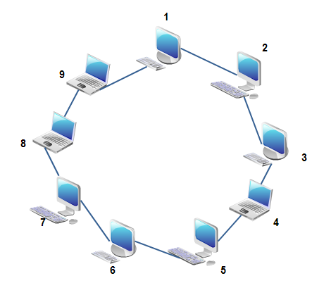
Definitions (3/3)
Ring network: It is a network where each node is connected to exactly two other nodes. In this way every nodes forms a single path from itself to it’s adjacent nodes.

Slide 8
Considered Scenario: Mobile Agent in Rendezvous in a Ring
Given a particular agent model and network model, a set of k agents distributed arbitrarily over the nodes of the network are said to rendezvous if after running their programs after some finite time they all occupy the same node of the network at the same time. It is generally assumed that two agents occupying the same node can recognize this fact.
In our study we consider the case of 2 mobile agents in rendezvous.

Slide 9
Rendezvous Problem Asymmetry
Asymmetry in a rendezvous problem may arise from:
Network: A network is asymmetric if it has one or more uniquely distinguishable vertices.
Agents: Agents have unique identities that allow them to act diﬀerently depending upon their values.
*Common approach is called Wait For Mummy ☺ (WFM)

Slide 10
Rendezvous Problem Symmetry
Symmetry: In the case of symmetric rendezvous, both the network and the agents are assumed to be anonymous.
Randomized rendezvous: Rendezvous may be solved by anonymous agents on an anonymous network by having the agents perform a random walk. The expected time to rendezvous is then a (polynomial) function of the (size of the) network and is directly related to the cover time of the network.
Rendezvous using token: Every agent mark its starting node with a unique token. Then the agents perform a walk and stop in two cases:
1: An agent find a previously marked node
2: The agents meet each others in a node, then the rendezvous is solved.

Slide 11
An Important Note:
It’s not possible to solve all rendezvous problems. This will depend upon both the properties of the agents (deterministic or randomized, anonymous or with identities, knowledge of the size of the network or not, etc.) and the network (synchronous or asynchronous, anonymous or with identities, tokens available or not, etc.). The solvability is also a function of the starting positions chosen for the agents.

Slide 12
The Problem and The Algorithm
Case of two parachutists who land in unkwon territory and must meet as soon as possible. The propsed solution is that parchutists meet at a focal point, i.e. a distinguished point in landscape. [4]
Many incremental ways of approaching this issue.
Divide the location into n identical discrete location and two identical searchers.
n= dintinctly labelled number of nodes.
n can be put in a structure which form a topology of a network.

Slide 13
Three location strategy:
If three discrete location comprised a ring the searcher should follow ∏ “Pi” strategy.
Chose the first location at random and then choose subsequent moves in pairs. That is, if a rendezvous does not occur after step j,j=1,3,5,.., then for the next two steps a searcher either returns to the location visited in step 1 or it visits the two other locations in random order.
Result expected rendezvous time is then 10/3.

Slide 14
Probabilistic Methods for searching random locations with equal probability.
Another Extension : Searchers start searching at different times or they could move between locations at any time.
Last Extension : Searchers could leave messages at locations they have searched.

Slide 15
Semi Symmetric Networks and How to Break It
Randomized Rendezvous: Rendezvous may be solved by anonymous agents on an anonymous network by having the agents perform a random walk.
The expected time to rendezvous is then a (polynomial) function of the (size of the) network and is directly related to the cover time of the network.
For example, it is straightforward to show that two agents performing a symmetric random walk on ring of size n will rendezvous within expected O(n2) time. This expected time can be improved by considering the following strategy (for a ring with sense of direction). Repeat the following until rendezvous is achieved: flip a (fair) coin and walk n/2 steps to the right
if the result is heads, n/2 steps to the left if the result is tails. If the two agents choose different directions
(which they do with probability 1/2) then they will rendezvous (at least on an edge if not at a node). It is easy to see that expected time until rendezvous is O(n).Referred as Coin Half Tour
Note that the agents are required to count up to n and thus seem to require
O(log n) bits of memory to perform this algorithm (whereas the straightforward random walk requires only a constant number of states to implement).

Slide 16
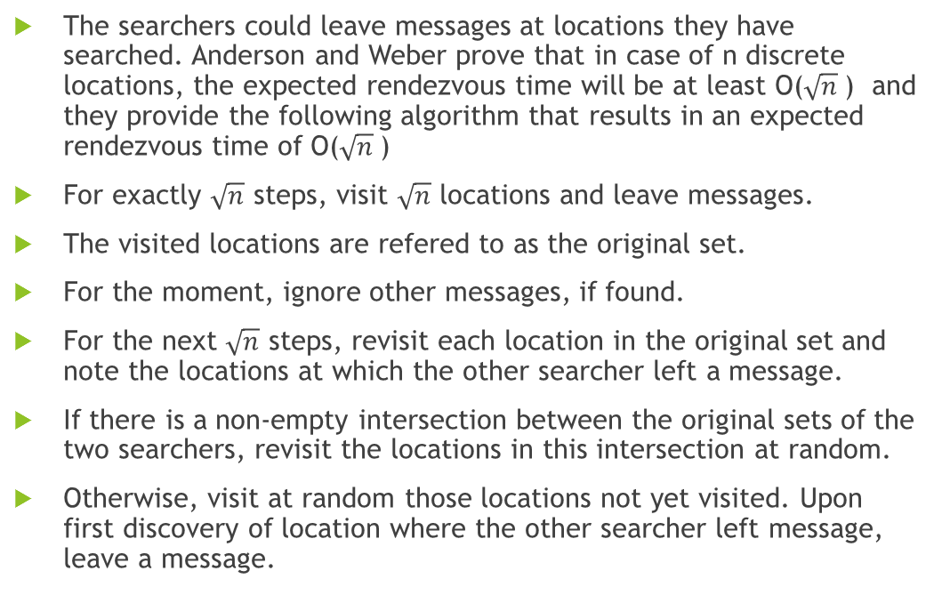
Another Approach
The searchers could leave messages at locations they have searched. Anderson and Weber prove that in case of n discrete locations, the expected rendezvous time will be at least O($\sqrt{n}$) and they provide the following algorithm that results in an expected rendezvous time of O($\sqrt{n}$)
For exactly $\sqrt{n}$ steps, visit $\sqrt{n}$ locations and leave messages.
The visited locations are refered to as the original set.
For the moment, ignore other messages, if found.
For the next $\sqrt{n}$ steps, revisit each location in the original set and note the locations at which the other searcher left a message.
If there is a non-empty intersection between the original sets of the two searchers, revisit the locations in this intersection at random.
Otherwise, visit at random those locations not yet visited. Upon first discovery of location where the other searcher left message, leave a message.

Slide 17
Contd…
Revisit locations in the original set at random until a message left by the other searcher is discovered.
Then uniformaly distribute visits between the two locations which both searchers have visited

Slide 18
Conclusion
Rendezvous problem is solvable under particular conditions and there are multiple ways to approach this classic problem.
Some open ended questions still remain : A friend has given you the name but not the address of a restaurant in downtown. Manhattan. You start searching for the restaurant by asking passersby which direction the restaurant is in. Their answers are sometimes erroneous, even contradictory. What is the best strategy to use in order to find the restaurant quickly?
Just saying… ☺

Slide 19
References
1. S. Alpern, Hide and Seek Games, Seminar, Institut f¨ur H¨ohere Studien,Wien, July1976.
2. S. Alpern, The Rendezvous Search Problem, SIAM Journal of Control and Optimization,33, pp. 673-683, 1995.
3.Kranakis, E., Krizanc, D. and Rajsbaum, S., 2006. Mobile agent rendezvous: A survey. In Structural Information and Communication Complexity (pp. 1-9). Springer Berlin Heidelberg.
4. https://curve.carleton.ca/system/files/etd/981d3518-3670-432f-b310-5cbe2432f37a/etd_pdf/aaa7a1c79e7c91f760219ca0822899af/sawchuk-mobileagentrendezvousinthering.pdf

Slide 20
Thank you! ☺

